Slide 1
AXS Event Insights
Kweku Ulzen
NYC Data Science Academy: Cohort #12

Slide 2
Agenda
Business Problem
Methodology
Scraping
Insights
Future State

Slide 3

About AXS
AXS is a digital marketing platform for purchasing tickets for sports and entertainment events in the US, and overseas.
Partner with promoters and venues to sell tickets directly to consumers
Large customer base in New York, Los Angeles, Atlanta, and London
Clearly dislike people scraping their website

Slide 4
Business Problems
Book artists to perform in front of their optimal audience
Appropriately price venue and show
Schedule performer at the right time of week
Choose a venue of adequate size
Identify new growth opportunities

Slide 5
Methodology
Identify metrics to solve business problems
1
Scrape AXS Events
2
Clean Data
3
Visualize Insights
4

Slide 6
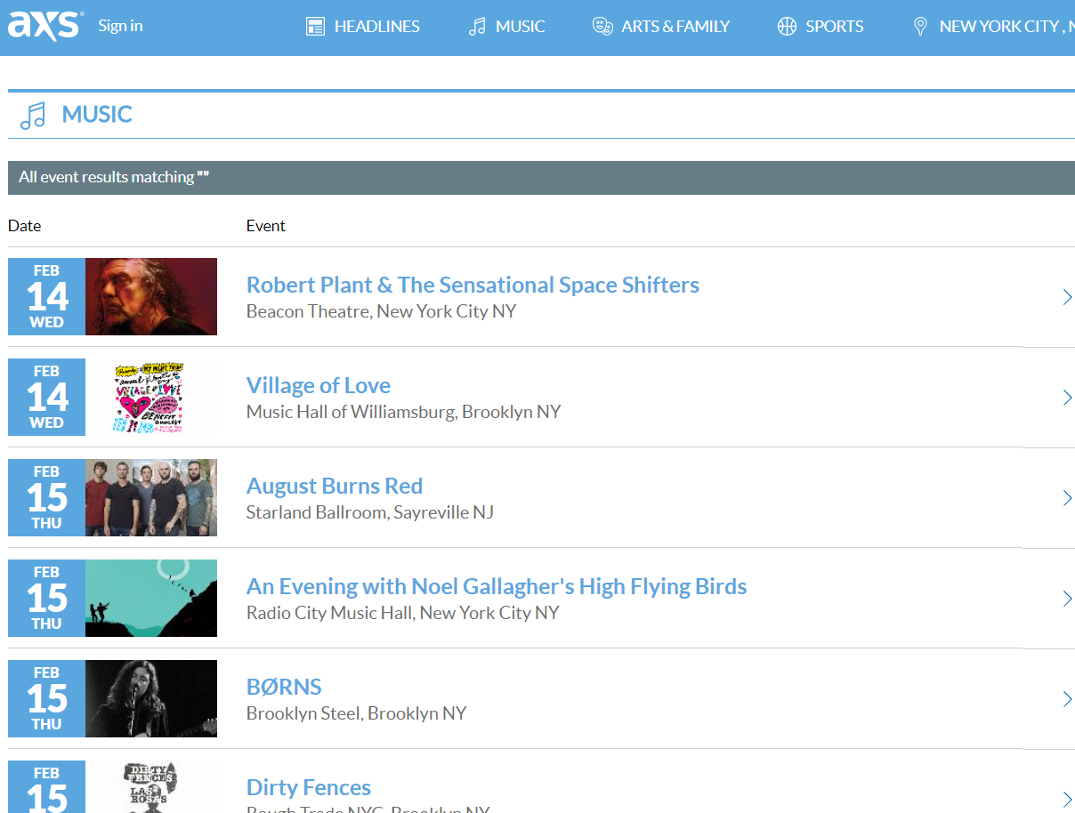
Scraping
Notes:
Site image

Slide 7
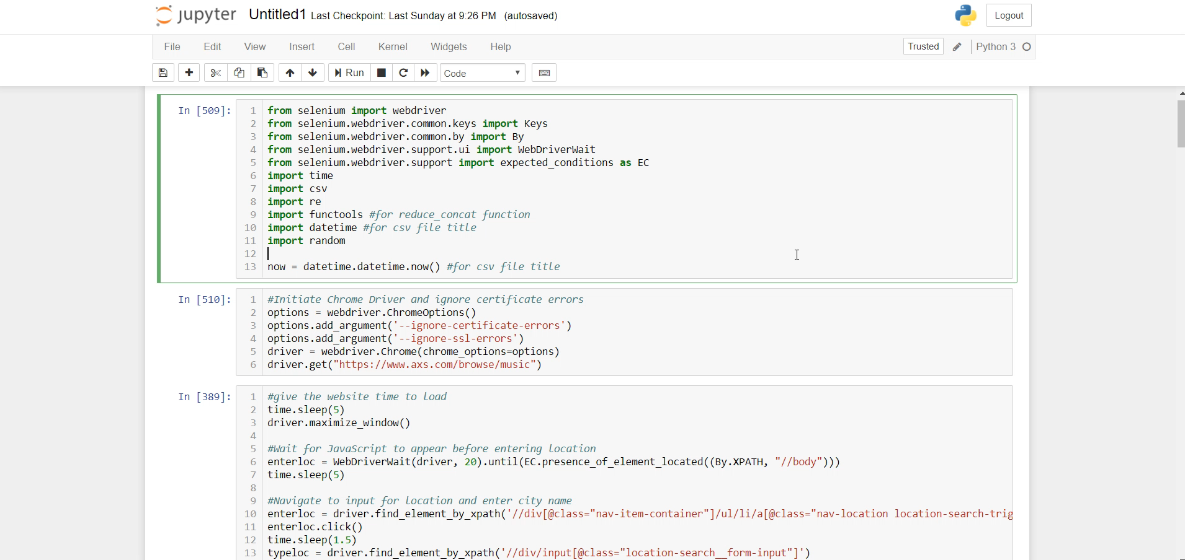
Scraping
Notes:
DATA SCRAPED – only 53 observations

Slide 8

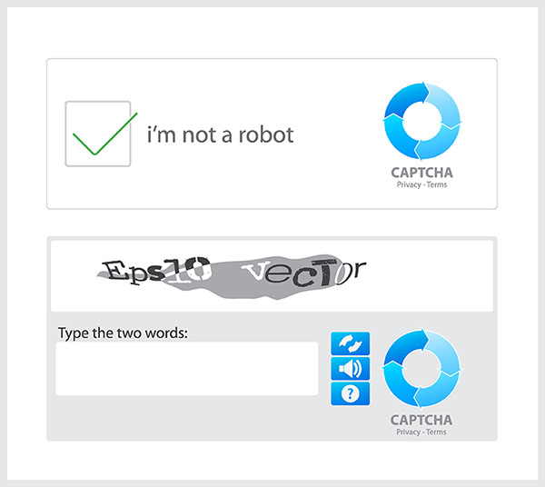


Scraping
Notes:
CAPTCHA
VPN
MOTION CAPTCHA

Slide 9
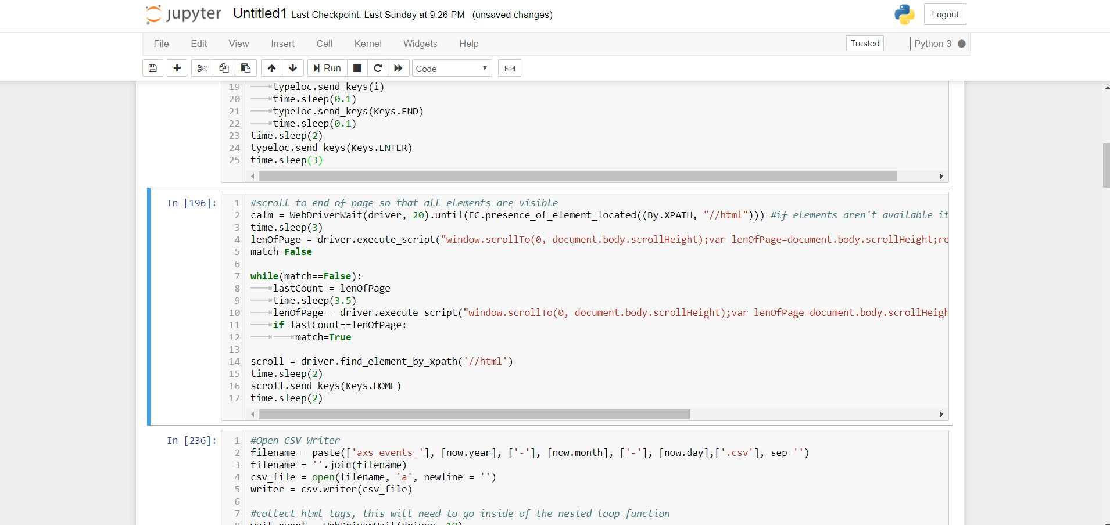
Scraping
Notes:
CHANGING DATA!

Slide 10
Data Cleansing Tasks
Tasks | Action
Combine dates | Apply to_datetime function to combine independent month day and year features; create Boolean weekend column
Remove duplicates | df.drop_duplicates()
Remove commas from venue | Regex replace ‘,’ with ‘’ on desired column
Split performers on key words | Regex split on ‘with’ | ‘*:’ | ‘and’ in a reversed list
Remove extra characters from time | Split on ‘- ‘ to remove city from time
Convert string time to a time type | Apply to_datetime function
Remove extra characters from price | Regex split on ‘ – ’ | ‘starting from: ’ to eliminate non-numeric characters
Split price into low and high column | Create new columns in dataframe for items in columns created from split
Reorder columns | Send column names to list and manipulate
Visualize | Plotly

Slide 11

Insights
Ticket Prices
Best weekdays for events
Well represented venues
Artist concert opportunities

Slide 12
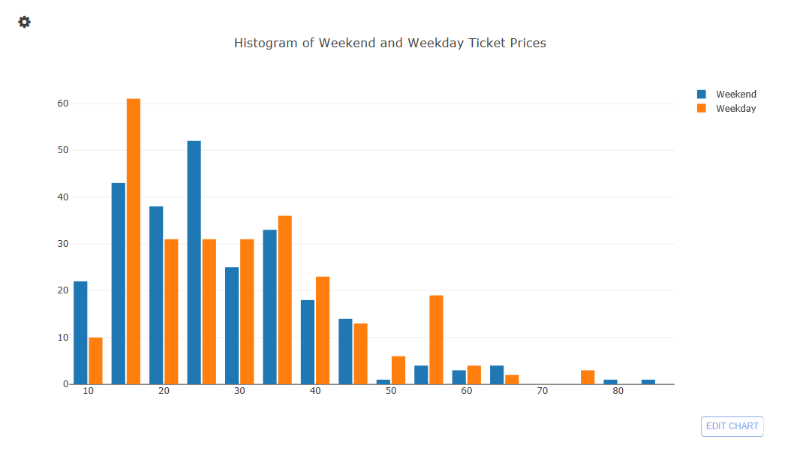
Count
Price

Slide 13
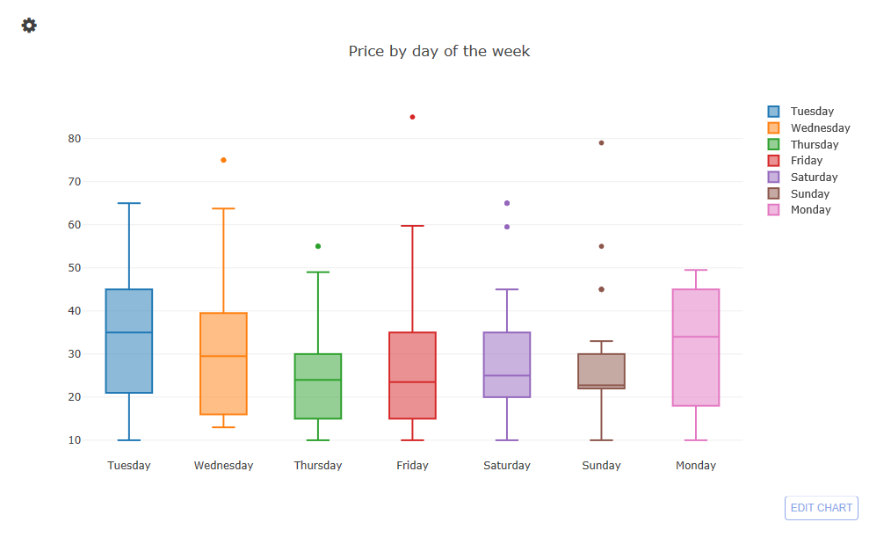
Count
Weekday

Slide 14
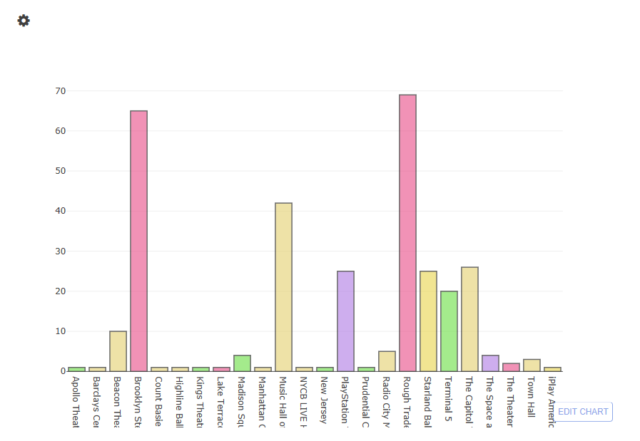
Events by Venue
Count
Venue

Slide 15
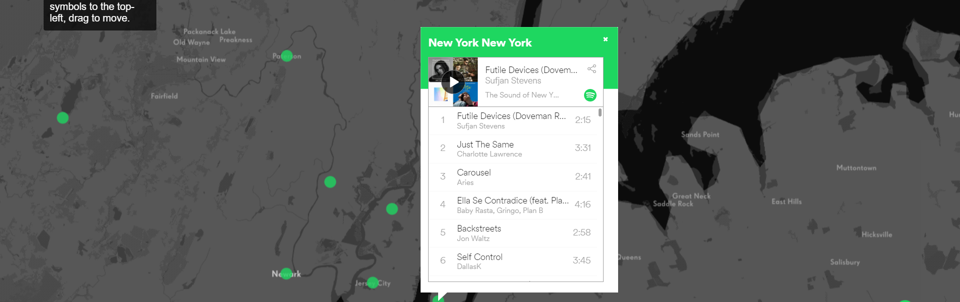
Opportunities

Slide 16
Future State
Organize
Organize data for consumers to more easily plan events and purchases
Map
Map locations of concerts
Incorporate
Incorporate Spotify API to alert consumers of similar concerts
Combine
Combine with larger ticket sites to have a larger sample of events
Perform
Perform analysis for sporting events, comedy, and theatre
Collect
Continuously collect information to predict future occurrences against historical data

